Slide 1

Scrum-Agile Presentation
Richard Elphinstone
CS-250 Software Development Life Cycle
Southern New Hampshire University
August 14th, 2022

Slide 2




Introduction
This is a discussion about using a Scrum-Agile approach to software development that was practiced in the SNHU Travel Project. We will review the Scrum-Agile approach and then compare with the Waterfall approach as it could apply with the SNHU Travel Project.

Slide 3



Roles on a Scrum-Agile Team
Scrum Master
Product Owner
Development Team (Developer)
Responsible for guiding team through Scrum practices and theory. This person facilitates the Scrum Events and looks for ways of removing road-blocks that may inhibit the team’s progress. This role’s goal is to progress a team to a high performing team. (Schwaber & Sutherland, 2020)
Acts as liaison to the client about what the product should be and include. Creates and maintains a Product Backlog of user stories that is prioritized to ensure the most important aspects of the product are accomplished. Continues to refine user stories to ensure they coincide with the client’s wishes. (Schwaber & Sutherland, 2020)
The group that takes user stories and turns them into deliverables. They are responsible for giving estimates of completion for user stories in the Product Backlog for a given Sprint . This group can contain members who specialize in development or testing, although there should be no actual such roles assigned. This team should be cross-functional and individual team members focus on accountability of the Development Team. This group is responsible to deliver a “Done” increment of the product by the end of the Sprint. (Cobb, 2015)

Slide 4
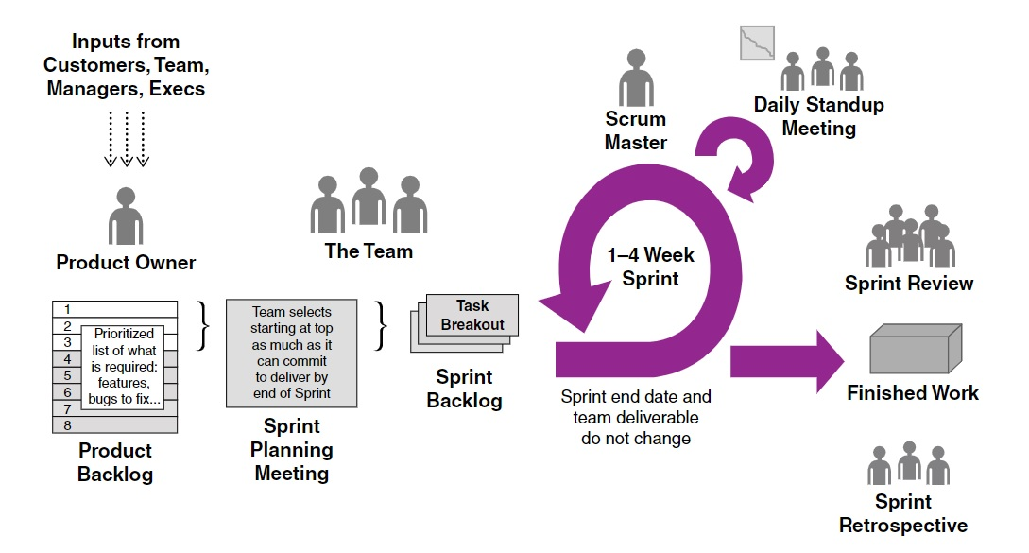
The SDLC of a Scrum-Agile approach

Slide 5
Phases of SDLC of a Scrum-Agile Approach
The Sprint
SPRINT PLANNING
Product Backlog Creation
Location and time of the meeting is facilitated by the Scrum Master. (Cobb, 2015)
FIRST: The Development Team informs the Product Owner of estimates of which user stories of the Product Backlog can be completed “Done” in the next Sprint. (Cobb, 2015)
SECOND: The Development Team (Without the Product Owner) discuss the division of tasks amongst the team for the coming Sprint. (Cobb, 2015)
Product Owner meets with client to discuss product and develops user stories that will be listed in the Product Backlog. (Cobb, 2015)
Product Owner then refines and prioritizes the Product Backlog in preparation for the Sprint Planning event. (Cobb, 2015)

Slide 6
..Continued
Daily Standup (Daily Scrum)
Facilitated by the Scum Master in a centralized and known location and time everyday. (Cobb, 2015)
Should only last 15 minutes. (Schwaber & Sutherland, 2020)
Scrum Master may lead to begin but it is the general idea that each member of the Development Team presents their information. (Cobb, 2015)
The information in general relates to what each member accomplished yesterday, what they plan to accomplish today, and what obstacles are in the way. (Cobb, 2015)
The use of Information Radiators in physical or electronic form is considered a good practice to feature at the Daily Standup (Cobb, 2015)

Slide 7
..Continued
Sprint review
Sprint Retrospective
Facilitated by the Scrum Master. (Cobb, 2015)
The Development Team presents the Product of the Sprint for review and approval of the Product Owner and possibly clients. (Cobb, 2015)
Feedback is used to make any updates to the Product Backlog for the next Sprint. (Schwaber & Sutherland, 2020)
Usually held immediately after the Sprint Review. (Cobb, 2015)
In this meeting the Development Team discusses what worked well and what did not for the team during the Sprint. (Schwaber & Sutherland, 2020)
Any ideas brought forward by the Development Team is then ideally applied in the next Sprint. (Schwaber & Sutherland, 2020)

Slide 8
Affects of choosing a Waterfall Approach
In our SNHU Travel project, we would plan the entire product out with the client first with a Waterfall approach. From there, a production would be established to meet the requirements of the product. Once completed the final product would then be delivered to the client. (Cobb, 2015)
A major issue with the Waterfall Method, in our given example, was the change in scope of what the client perceived as a niche vacation. In the middle of development, the client decided their niche vacation would consist of wellness/detox vacation destinations. (SNHU Travel Project, 2022)
In a Waterfall approach, changes like this would not have been reviewed until the product was completed and delivered. There is no way to backtrack and change requirements with Waterfall. (Cobb, 2015)
This would have left the client with a Product that did not fulfill their specific desires.
With a Scrum-Agile approach, the Product Backlog could be updated and prioritized. Although it is best to add changes before the next Sprint, the change was applied during the Sprint. After the Product Backlog was re-prioritized, this newer feature of a niche wellness/detox vacation focus was prioritized with less prioritized features possibly not making “Done” completion at Sprint Review. (Cobb, 2015)
This is acceptable with Scrum-Agile and ensures that the highest priority user stories are completed. This then ensure the delivery of a product that is closer to the clients wishes. (Cobb, 2015)

Slide 9
Choosing Waterfall or Agile
First it is important to note that both approaches have uses and that neither one is necessarily the correct answer for every situation. (Cobb, 2015)
WATERFALL: A product that has clear requirements and does not pose risk to having to be adaptive can benefit from the linear progression of a Waterfall approach. The client in this approach is only included in the initial planning and review of the final product as the entire development is plan driven. (Cobb, 2015)
SCRUM-AGILE: For a product that may find itself susceptible to alteration during development can benefit from the Scrum-Agile approach. This approach can identify issues brought by the client, Product Owner, or Development Team can be addressed through multiple iteration of Sprints until the product is at an acceptable state for the client. This makes the development flexible to be more adaptative to changes. (Cobb, 2015)

Slide 10

Summary
Both the Waterfall and Scrum-Agile approaches to Software Development Life Cycle have pros and cons. However, after reviewing the development process of the SNHU Travel Project and the changes that were brought up during development, I found the Scrum-Agile approach to be much more flexible. With this, it is my recommendation for Chada Tech to progress towards a full transition to the Scrum-Agile approach in software development. This will help us stay adaptative with today’s always-changing business environment. (SNHU Travel Project, 2022)

Slide 11


References:
Cobb, G. (2015) The Project Manager’s Guide to Mastering Agile: Principles and Practices for an Adaptive Approach. John Wiley & Sons
Schwaber, K. & Sutherland, J. (November 2020) The Scrum Guide: The Definitive Guide to Scrum: The Rules of the Game. Retrieved from: https://scrumguides.org/docs/scrumguide/v2020/2020-Scrum-Guide-US.pdf#zoom=100
SNHU Travel Project (2022) [Course CS-250] Southern New Hampshire University

Slide 12
Thank You
Richard Elphinstone
CS-250 Software Development Life Cycle
Southern New Hampshire University
August 14th, 2022

